Slide 1
Cpp-Taskflow: Fast Task-based Parallel Programming using Modern C++
Tsung-Wei Huang, C.-X. Lin, G. Guo, and M. Wong
Department of Electrical and Computer Engineering
University of Illinois at Urbana-Champaign, IL, USA
Notes:
Hello everybody. Welcome to my presentation. Today I am going to talk about Cpp-Taskflow, fast task-based parallel programming using modern C++. This is a practical research project about how to make it easier for developers to write parallel programs in modern C++.

Slide 2
Cpp-Taskflow’s Project Mantra
A programming library helps developers quickly write efficient parallel programs on a shared-memory architecture using task-based approaches in modern C++
Task-based approach scales best with multicore arch
We should write tasks instead of threads
Not trivial due to dependencies (race, lock, bugs, etc)
We want developers to write parallel code that is:
Simple, expressive, and transparent
We don’t want developers to manage:
Explicit thread management
Difficult concurrency controls and daunting class objects
Notes:
Let me cut into the main point. ***The goal of Cpp-Taskflow is to help developers quickly write efficient parallel programs on a shared-memory architecture using task-based approaches in modern C++.*** We know through the evolution of parallel programming standards, task-based approach is becoming the most promising solution to scale up with the future multicore architecture. When we write parallel programs, we should write tasks instead of threads. Task is a much better abstraction than threads. However, task programming is not an easy job because of dependencies. Some tasks have to run before others and some have to go after others. This is the root of evil (race condition, lock, contention, buggy code). We don’t want developers to suffer from these problems.
In Cpp-Taskflow, we want task-based parallel code to be simple, expressive, and transparent. By looking at the code, it has to explain itself. We don’t want developers to attack difficult details, for instance, explicit thread management, difficult lock controls and daunting class declaration.

Slide 3
Hello-World in Cpp-Taskflow
#include <taskflow/taskflow.hpp> // Cpp-Taskflow is header-only
int main(){
tf::Taskflow tf;
auto [A, B, C, D] = tf.emplace(
[] () { std::cout << "TaskA\n"; }
[] () { std::cout << "TaskB\n"; },
[] () { std::cout << "TaskC\n"; },
[] () { std::cout << "TaskD\n"; }
);
A.precede(B); // A runs before B
A.precede(C); // A runs before C
B.precede(D); // B runs before D
C.precede(D); // C runs before D
tf::Executor().run(tf); // create an executor to run the taskflow
return 0;
}
Only 15 lines of code to get a parallel task execution!
Notes:
Suppose we have a “hello-world” task dependency graph like this, four tasks (A, B, C, D) and four dependencies. A has to run before B and C, and B and C have to run before D. This is how it looks in Cpp-Taskflow. Only 15 lines of code to get a parallel task execution. This is all you need. You create a taskflow object to manage a task dependency graph. You emplace four tasks to the taskflow. Each task is described in a C++ lambda. Then you use the method precede to add a dependency link between two tasks. In this case, A precedes B, B … Then you use an executor to run the taskflow object.
Cpp-Taskflow is header only. In order to use Cpp-Taskflow, you don’t need to compile anything but copying the header files to your project and include these headers. Pretty much everybody can get their first cpp-takslfow program up and running in just 5 minutes.

Slide 4
Hello-World in OpenMP
#include <omp.h> // OpenMP is a lang ext to describe parallelism in compiler directives
int main(){
#omp parallel num_threads(std::thread::hardware_concurrency())
{
int A_B, A_C, B_D, C_D;
#pragma omp task depend(out: A_B, A_C)
{
s t d : : c o u t << ”TaskA\n” ;
}
#pragma omp task depend(in: A_B; out: B_D) {
s t d : : c o u t << ” TaskB\n” ;
}
#pragma omp task depend(in: A_C; out: C_D) {
s t d : : c o u t << ” TaskC\n” ;
}
#pragma omp task depend(in: B_D, C_D)
{
s t d : : c o u t << ”TaskD\n” ;
}
}
return 0;
}
Task dependency clauses
Task dependency clauses
Task dependency clauses
Task dependency clauses
OpenMP task clauses are static and explicit; Programmers are responsible a proper order of writing tasks consistent with sequential execution
Notes:
The same example is showing here but written in OpenMP’s tasking interface. I am sure most of you know what OpenMP is and it is a very popular programming API and language extension to describe parallelism using compiler directives. Starting from version 4.0, OpenMP introduces the task dependency clause that allows programmers to explicitly specify the task dependency in their program. In this example, we create four tasks using pragma omp task syntax. Next, we use depend clause to specify the dependency constraint between tasks. For example, we write a clause in task A with two out-going edges to B and C, to force A to run before B and C. Similarly in task B, there is an in-coming edge from A and another out-going edge to D, which means B runs after A and B runs before D. We do the same thing for tasks C and D.
This code is not complicated. However, it’s hard to understand at the first look. I need to spend a bit more time to figure out the syntax task and depend clause. Another problem is … Imagine you are compiling this program with openmp disabled, everything falls back to sequential execution. The order of executing these tasks has to be topologically consistent with the dependency graph. For example, you can not write task D before task A in this case. This is problematic as in many programs I can’t decide tasks in advance.

Slide 5
Hello-World in Intel’s TBB Library
#include <tbb.h> // Intel’s TBB is a general-purpose parallel programming library in C++
int main(){
using namespace tbb;
using namespace tbb:flow;
int n = task_scheduler init::default_num_threads () ;
task scheduler_init init(n);
graph g;
continue_node<continue_msg> A(g, [] (const continue msg &) {
s t d : : c o u t << “TaskA” ;
}) ;
continue_node<continue_msg> B(g, [] (const continue msg &) {
s t d : : c o u t << “TaskB” ;
}) ;
continue_node<continue_msg> C(g, [] (const continue msg &) {
s t d : : c o u t << “TaskC” ;
}) ;
continue_node<continue_msg> C(g, [] (const continue msg &) {
s t d : : c o u t << “TaskD” ;
}) ;
make_edge(A, B);
make_edge(A, C);
make_edge(B, D);
make_edge(C, D);
A.try_put(continue_msg());
g.wait_for_all();
}
Use TBB’s FlowGraph for task parallelism
Declare a task as a continue_node
TBB has excellent performance in generic parallel computing. Its drawback is mostly in the ease-of-use standpoint (simplicity, expressivity, and programmability).
Somehow, this looks more like “hello universe” …
Notes:
Again, the same example in Intel’s Threading building block library, or TBB for short. TBB is a general-purpose object-oriented parallel programming library in C++. It has been in the industry for years. The idea of TBB is very similar to Cpp-Taskflow in the sense it describes dependent tasks using a flowgraph. You can create a task node and add an edge between tasks for a dependency constraint, and dispatch the graph to its global task scheduler. TBB has excellent …
For example, to create a task, you need to understand this monster class template “continue_node” and “continue_msg”. Believe or not, I barely understand them for now. It turns out these features are powerful but not useful for most of the workloads we need.

Slide 6
A Slightly More Complicated Example
// source dependencies
S.precede(a0); // S runs before a0
S.precede(b0); // S runs before b0
S.precede(a1); // S runs before a1
// a_ -> others
a0.precede(a1); // a0 runs before a1
a0.precede(b2); // a0 runs before b2
a1.precede(a2); // a1 runs before a2
a1.precede(b3); // a1 runs before b3
a2.precede(a3); // a2 runs before a3
// b_ -> others
b0.precede(b1); // b0 runs before b1
b1.precede(b2); // b1 runs before b2
b2.precede(b3); // b2 runs before b3
b2.precede(a3); // b2 runs before a3
// target dependencies
a3.precede(T); // a3 runs before T
b1.precede(T); // b1 runs before T
b3.precede(T); // b3 runs before T
Still simple in Cpp-Taskflow
Notes:
A slightly more complicated example with 10 tasks and 15 dependency constraint. Still simple in cpp-taskflow. The source lines of code to write is linearly promotional to the size of the graph or it can be even fewer because of the use of modern c++ syntax. The code rarely blows up when graph becomes large.

Slide 7
Our Goal of Parallel Task Programming
NO redundant and boilerplate code
Programmability
NO difficult concurrency control details
NO taking away the control over system details
Transparency
Performance
“We want to let users easily express their parallel computing workload without taking away the control over system details to achieve high performance, using our expressive API in modern C++”
Notes:
This is our goal. This is a well known iron triangle. If you are developing a parallel programming library or model, you will have mostly these three things to consider. You will use them to characterize and examine a parallel programming model and see whether it is giving more favor to programmability, transparency, or performance.
Programmability for most people means the ease of use in your library. How easy can I get started to see the benefit of using your library? Transparency means abstraction. I wanna focus on high-level development or parallel decomposition strategy, instead of dealing with low-level details such as concurrency controls and job scheduling. Performance means runtime and it can be affected by latency and throughput. People who are obsessed about performance do not want you to take away the control over system details. For example, they love C/C++ because of the flexibility in deciding performance in much detail.

Slide 8
Keep Programmability in Mind
In the cloud era …
Hardware is just a commodity
Building a cluster is cheap
Coding takes people and time
Programmability can affect the performance and productivity in many aspects (details, styles, high-level decisions, etc.)!
2018 Avg Software Engineer salary (NY) > $170K
Notes:
We should always keep programmability in mind. In the cloud era, hardware is just a commodity. It’s easy to build an environment with massively parallel computing resources. It is coding that takes people and time. The cost of what are left with is the programmer, who provide the added values. This is why the software engineer jobs are so popular today because they get paid very high. It’s important to keep them productive. And we know productivity has a lot to do with system programmability. It can affect the “performance” and “productivity” in all aspects from detailed implementations to high-level software architecture decision making.
So, improving the programmability of a system is not only making programming easier and faster, but also enabling a new innovation to solve problems more efficiently.

Slide 9
Why Task Parallelism?
Project Motivation: Large-scale VLSI timing analysis
Extremely large and complex task dependencies
Irregular compute patterns
Incremental and dynamic control flows
Existing solutions (including OpenTimer*)
Based on OpenMP mostly
Loop-based parallelism
Specialized data structures
Need task-based approach
Flow computations naturally with the graph structure
Tasks and dependencies are just the timing graph
*A High-performance VLSI timing analyzer: https://github.com/OpenTimer/OpenTimer
Notes:
A really important question here is: why do we use task parallelism? The main motivation behind this project was to solve a large-scale VLSI timing analysis. Timing analysis is a key step in the over circuit design flow because it verifies the expected timing behaviors of the chip to ensure they function correctly after tape-out. Today the design complexity is very huge and I am talking about billions of transistors. The resulting timing graph is often too large to compute efficiently.
At the same time timing analysis is very challenging. First, it has extremely large and complex task dependencies. In order to analyze the timing, we need to collect a bunch of information such as input slew, load capacitance, arrival time, and required arrival time. These quantities are dependent of each other. You cannot compute one quantity before another finishes. Second, timing analysis has very irregular compute patterns. What we always do is to model the timing as a graph workload and analyze criticality by finding a shortest path or a longest path. Apparently, computing graph is not regular. It’s not something you can model as a matrix operation that is regular. Finally, which is also the most challenging part is the incrementality. (explain …). Combining these challenges together, it is not an easy task to develop a scalable parallel timing analysis tool.
What do existing work do? Most of the existing works are based on OpenMP, and this includes our standalone timing analysis tool OpenTimer. The idea here is simple. We levelized a graph and apply loop-based strategy to pipeline the computation in parallel. All the nodes that reside in the same level can run in parallel but need to synchronize level by level. As you can see, we need a specialized data structure to make this happen. Sometimes, maintaining these data structures from time to time can overwhelm the benefit of loop-based strategy. So we observed, it is often not the parallel computing part that limits your application scalability, but the surrounding data structures you need to implement the parallel computing. This is definitely not a good or scalable solution.
So we need a better approach. We want task-based approach. By modeling each computing unit as a task, we are able to flow computations …

Slide 10
Getting Started with Cpp-Taskflow
Step 1: Create a taskflow object and task(s)
Use tf::Taskflow to create a task dependency graph
A task is a C++ callable objects (std::invoke)
Step 2: Add dependencies between tasks
Force one task to run before (or after) another
Step 3: Create an executor to run the taskflow
An executor manages a set of worker threads
Schedules the task execution through work-stealing
Notes:
While the initial goal of Cpp-Taskflow was to solve our VLSI timing analysis problem, we decided to make it an independent C++ library to benefit generic users. Here are three steps to write a Cpp-Taskflow program.
Step 1, you use the tf::Taskflow class to create a taskflow object that manages a task dependency graph. A task is a C++ callable objects for which std::invoke is applicable. It can be a lambda expression, function object, or a bind expression. C++ lambda is quite flexible because it allows us to capture literally everything in the code
After you create a set of tasks, you will add dependencies between tasks. This is to force one task to run before or after another.
Step 3, you will create an executor to run the taskflow. An executor is an object that manages a set of worker threads. When you dispatch a task dependency graph, it wakes up the worker threads to execute the tasks using an efficient work-stealing algorithm.

Slide 11
Revisit Hello-World in Cpp-Taskflow
#include <taskflow/taskflow.hpp>
int main(){
tf::Taskflow tf;
auto [A, B, C, D] = tf.emplace(
[] () { std::cout << "TaskA\n"; }
[] () { std::cout << "TaskB\n"; },
[] () { std::cout << "TaskC\n"; },
[] () { std::cout << "TaskD\n"; }
);
A.precede(B); // A runs before B
A.precede(C); // A runs before C
B.precede(D); // B runs before D
C.precede(D); // C runs before D
tf::Executor().run(tf);
return 0;
}
Step 1:
- Create a taskflow object
- Create tasks
Step 2:
- Add task dependencies
Step 3:
- Create an executor to run
Notes:
Let’s revisit this hello-world program again to see how this three steps actually maps to the program. At step 1, you create a taskflow object with four tasks each doing nothing but showing its own identity. Next, you will use the precede method to add dependency links between tasks. A has to run before B, A has to run before C, B has to run before D, and C has to run before D. Finally, you create an executor on the fly in this case to run this dependency graph. You should be able to see the messages printed in the order A B C D or A C B D, because B and C can run in parallel.

Slide 12
Multiple Ways to Create a Task
// Create tasks one by one
tf:Task A = tf.emplace([] () { std::cout << "TaskA\n"; });
tf:Task B = tf.emplace([] () { std::cout << "TaskB\n"; });
// Create multiple tasks at one time
auto [A, B] = tf.emplace(
[] () { std::cout << "TaskA\n"; }
[] () { std::cout << "TaskB\n"; }
);
// Create an empty task (placefolder)
tf:Task empty = tf.placeholder();
// Modify task attributes
empty.name(“empty task”);
empty.work([] () { std::cout << "TaskA\n"; });
tf::Task is a lightweight handle to let you access/modify a task’s attributes
Notes:
Each time you create a task, it returns to you a task object. A task object is not a real task that run the actual job but a lightweight handle to let you access or modify a task’s attributes. For example, you can add dependency link between tasks, giving a name to a task, and change the target callable. We provide this handle as an extensible layer to give users a safe API without touching the underlying data structure or the graph node. This separation also makes it clear between what users can do and what users can’t do.
We use the C++ parameter pack to implement the task creation, so you can also create multiple tasks at one time using a single function call.

Slide 13
Add a Task Dependency
// Create two tasks A and B
tf:Task A = tf.emplace([] () { std::cout << "TaskA\n"; });
tf:Task B = tf.emplace([] () { std::cout << "TaskB\n"; });
…
// Create a preceding link from A to B
A.precede(B);
// You can also create multiple preceding links at one time
A.precede(C, D, E);
// Create a gathering link from F to A (A run after F)
A.gather(F);
// Similarly, you can create multiple gathering links at one time
A.gather(G, H, I);
You can build any dependency graphs using precede
Notes:
To add a dependency link between tasks, we provide two methods precede and gather. Precede, by its name, adds a preceding link from a task to another. For example, here we have two tasks, A and B, calling “A precede B” forces A to run before B. You can also create multiple preceding links at one time, for instance, “A precede C D E” which creates three dependency links from A to C, D, and E. The method “precede” is the simplest and effective method in cpp-taskflow because you can pretty much build any dependency graphs using it.
On the opposite side, the method “gather” adds a dependency link from the opposite direction. (For example, calling “A gather F” will create a dependency link from F to A. Also, you can create multiple gathering links at one time. For example, calling “A gather G H I” will create three dependency links from A to G, H, and I.)

Slide 14
Static Tasking vs Dynamic Tasking
Static tasking
Defines the static structure of a parallel program
Tasks are within the first-level dependency graph
Dynamic tasking
Defines the runtime structure of a parallel program
Dynamic tasks are spawned by a parent task
These tasks are grouped together to form a “subflow”
A subflow is a taskflow created by a task
A subflow can join or be detached from its parent task
Subflow can be nested
Cpp-Taskflow has a uniform interface for both
Notes:
Now, I would like to talk about static tasking and dynamic tasking in cpp-taskflow. So far, all the examples we have seen are static tasking. Static tasking defines the static structure of a parallel program, or put it another way, static tasking refers to those tasks within the first-level of the dependency graph.
On the other hand defines the runtime structure of a parallel program. Dynamic tasks are spawned by a parent task. These tasks are grouped together to form a “subflow.” A subflow is a taskflow created by a task, it is created during the execution context of a task. A subflow can join or be detached from its parent task. Subflow can be nested and this is useful to implement recursive and complex flow controls.
A big idea her is we have a uniform interface for both static tasking and dynamic tasking.

Slide 15
Unified Interface for Static & Dynamic Tasking
// create three regular tasks
tf::Task A = tf.emplace([](){}).name("A");
tf::Task C = tf.emplace([](){}).name("C");
tf::Task D = tf.emplace([](){}).name("D");
// create a subflow graph (dynamic tasking)
tf::Task B = tf.emplace([] (tf::Subflow& subflow) {
tf::Task B1 = subflow.emplace([](){}).name("B1");
tf::Task B2 = subflow.emplace([](){}).name("B2");
tf::Task B3 = subflow.emplace([](){}).name("B3");
B1.precede(B3);
B2.precede(B3);
}).name("B");
A.precede(B); // B runs after A
A.precede(C); // C runs after A
B.precede(D); // D runs after B
C.precede(D); // D runs after C
Cpp-Taskflow uses std::variant to enable a uniform interface for both static tasking and dynamic tasking
Notes:
This slide gives an example of dynamic tasking. Cpp-Taskflow uses std::variant to enable a uniform interface for both static tasking and dynamic tasking. The main difference between creating a static task and a dynamic task is in the argument passed to the callable object. To create a static task, you just give a callable in a closure form that does not take any argument. For example, here we have task A, C, D, all the lambdas take no argument so they are static tasks.
Now, here in task B, it takes an argument of type tf::subflow. The subflow object is a taskflow-like object that is created during the execution of this task, task B, and passed to the callable to create another taskflow inside task B. In this example, task B spawns another task dependency graph of three tasks B1, B2, and B3 subject to B1 running before B3 and B2 running before B3.
As you can see, our interface is unified and uniform. All the graph creation methods applicable to static tasking also work for dynamic tasking. There is no need to learn a different API. By default a subflow will join its parent task to keep all subsequent dependencies.

Slide 16
Detached Subflow
// create three regular tasks
tf::Task A = tf.emplace([](){}).name("A");
tf::Task C = tf.emplace([](){}).name("C");
tf::Task D = tf.emplace([](){}).name("D");
// create a subflow graph (dynamic tasking)
tf::Task B = tf.emplace([] (tf::Subflow& subflow) {
tf::Task B1 = subflow.emplace([](){}).name("B1");
tf::Task B2 = subflow.emplace([](){}).name("B2");
tf::Task B3 = subflow.emplace([](){}).name("B3");
B1.precede(B3);
B2.precede(B3);
subflow.detach();
}).name("B");
A.precede(B); // B runs after A
A.precede(C); // C runs after A
B.precede(D); // D runs after B
C.precede(D); // D runs after C
Detaching a subflow separates its execution from its parent flow, allowing execution to continue independently
Notes:
You can detach a subflow by calling the method “detach” from a subflow. Detaching a subflow will …
Using the same example but here we detach the subflow spawned by B to enable the subflow B1, B2, and B3 run independently of its parent taskflow.

Slide 17
Nested Subflow
tf::Task A = tf.emplace([] (tf::Subflow& sbf) {
std::cout << "A spawns A1 & subflow A2\n";
tf::Task A1 = sbf.emplace([] () {
std::cout << "subtask A1\n"; }
).name("A1");
tf::Task A2 = sbf.emplace([] (tf::Subflow& sbf2) {
std::cout << "A2 spawns A2_1 & A2_2\n";
tf::Task A2_1 = sbf2.emplace([] () {
std::cout << "subtask A2_1\n";
}).name("A2_1");
tf::Task A2_2 = sbf2.emplace([] () {
std::cout << "subtask A2_2\n"; }
).name("A2_2");
A2_1.precede(A2_2);
}).name("A2");
A1.precede(A2);
}).name("A");
Powerful in defining recursive dynamic workloads
Notes:
Like I said, a subflow can be nested in theoretically unlimited number of layers. In this case, we do have a special care about how to avoid the stack overflow caused by the recursion. Nested subflow is very complex but sometimes useful to implement recursive control flows that require multiple layers of parallelism.

Slide 18
Executor
Executor is an execution object that manages:
A set of worker threads in a shared thread pool
Task scheduling using a work-stealing algorithm
Each dispatched taskflow is wrapped by a topology
A lightweight data structure used for synchronization
Notes:
When you finish describing a task dependency graph, the next step is to dispatch it to an executor to run dependent tasks. An executor is an execution object that manages a set of worker threads in a shared thread pool. Each task is executed by a thread using the popular work-stealing algorithm. We do have a specialized work stealing algorithm that is very effective and efficient to Cpp-Taskflow.
Internally, each dispatched taskflow is wrapped by a topology. A topology is a lightweight data structure used for synchronization. For example, when calling wait_for_all we need to synchronize with all running topologies to ensure all tasks finish.

Slide 19
Execute a Task Dependency Graph
// Create an executor with default worker numbers (hardware_curr)
tf:Executor executor;
auto future = executor.run(taskflow); // run the taskflow once
auto future2 = executor.run(taskflow, [](){ std::cout << "done 1 run\n"; } );
executor.run_n(taskflow, 4); // run four times
executor.run_n(taskflow, 4, [](){ std::cout << "done 4 runs\n"; });
// run n times until the predicate becomes true
executor.run_until(taskflow, [counter=4](){ return --counter == 0; } );
executor.run_until(taskflow, [counter=4](){ return --counter == 0; },
[](){ std::cout << "Execution finishes\n"; }
);
run methods are non-blocking
Multiple runs on a same taskflow will automatically synchronize to a sequential chain of execution
Notes:
The executor defines a rich set of execution methods to run one taskflow or multiple taskflows. You can run the taskflow one time, or multiple times as well. Multiple runs on a same taskflow will automatically synchronize to a sequential chain of execution. Each run method will return a std::future object so you can use it to inspect the execution status or pipeline it with your control flow.

Slide 20
Micro-benchmark Performance
Measured the “pure” tasking performance
Wavefront computing (regular compute pattern)
Graph traversal (irregular compute pattern)
Compared with OpenMP 4.5 and Intel TBB FlowGraph
G++ v8 with –fomp –O2 –std=c++17
Evaluated on a 4-core AMD CPU machine
Cpp-Taskflow scales the best when task counts (problem size) increases, using the least amount of code
Notes:
Now I would like to move on to the experiments. The first evaluation we made is micro-benchmarking. The goal of micro-benchmarking is to measure the “pure” library tasking performance (including task creation, scheduling, and ramp-up time) without actual computation. Here we tried to solve a task dependency graph representing a regular workload of matrix operation and an irregular workload of graph traversal. We compared with OpenMP 4.5 task dependency clauses and TBB FlowGraph in implementing the same task dependency graph. We compile the code with GCC v8.0 enabling the fopm, O2 and std::c++17 flags. We ran the experiments on a 4-core AMD CPU machine.
As you can see, Cpp-Taskflow is about 1.2-2x faster in executing the task dependency graph, more scalable than the other two especially when the task count goes large. It also reduces the coding effort by 2x fewer lines of code to OpenMP and TBB.

Slide 21
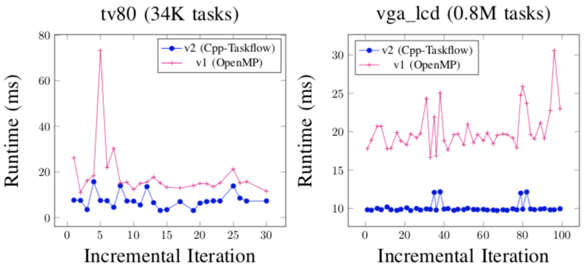
Large-Scale VLSI Timing Analysis
OpenTimer v1: A VLSI Static Timing Analysis Tool
v1 first released in 2015 (open-source under GPL)
Loop-based parallelism using OpenMP 4.0
OpenTimer v2: A New Parallel Incremental Timer
v2 first released in 2018 (open-source under MIT)
Task-based parallel decomposition using Cpp-Taskflow
Task dependency graph
(timing graph)
Cost to develop is $275K with OpenMP vs $130K with Cpp-Taskflow! (https://dwheeler.com/sloccount/)
v2 (Cpp-Taskflow) is 1.4-2x faster than v1 (OpenMP)
Notes:
Now, the next experiment is very interesting. We applied Cpp-Taskflow to solve a real-world problem, VLSI timing analysis, where we compare two versions of OpenTimer. Remember OpenTimer is a standalone VLSI timing analysis tool I have been developing for years. This is a real tool and is being used by many academic and industrial research projects so it is really a good benchmark. There are two versions, v1 and v2. The main difference is the new task-based design strategy for the core parallel incremental timing. V1 used the loop-based method where we levelized the graph and propagate the computation level by level using OpenMP. There is a lot of synchronization overhead.
V2 eliminated this problem and represented the entire computation using a task graph in cpp-taskflow. As you can see from this figure, we compared v1 with v2 on two real circuit designs tv80 and vga_lcd, and v2 in cpp-taskflow is able to gain up to 2x speed-up over openMP. I would like to highlight the point in v2 we don’t need extra effort to maintain a specialized data structure for the level list required in OpenMP-based strategy. This actually contributed a lot to the speed-up.
***Meanwhile by using cpp-taskflow, we reduced the coding efforts from about 9K lines to 4K lines. This really ”SAVE A LOT” programming efforts, and the real productivity gain is significant.***

Slide 22
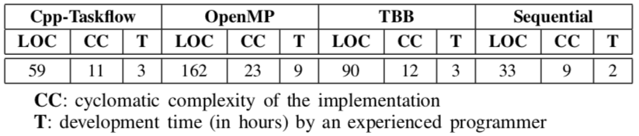
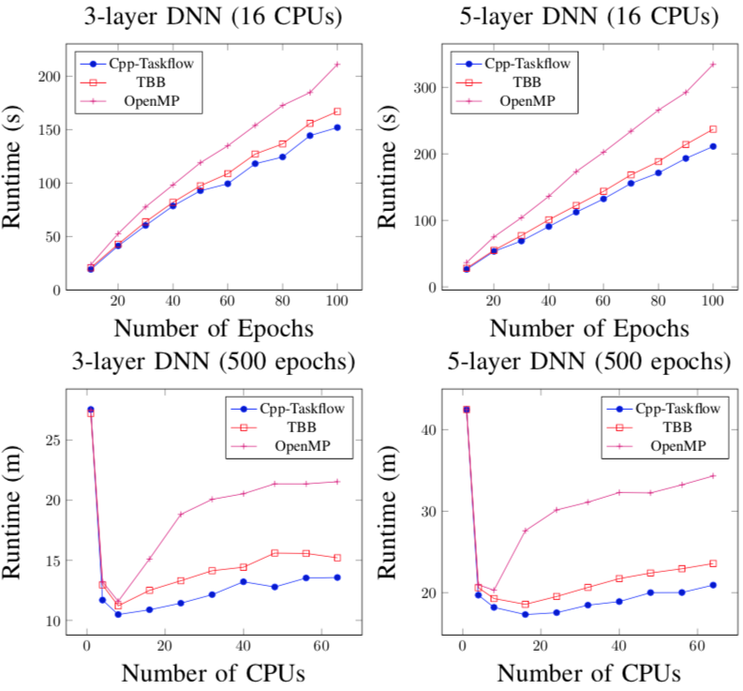
Deep Learning Model Training
3-layer DNN and 5-layer DNN image classifier
Dev time (hrs): 3 (Cpp-Taskflow) vs 9 (OpenMP)
Cpp-Taskflow is about 10%-17% faster than OpenMP and Intel TBB in avg, using the least amount of source code
Notes:
Another experiments we did is to apply cpp-taskflow to program a parallel training of a deep neural network. (joke: this is a lesson I learned. In order to get your paper accepted, it must have something to do with machine learning).
The general idea here is using task-based approach, we are able to easily describe the task dependencies within and outside the training iteration. For example, within the training iteration you can have forward propagation, backward propagation and weight update run in pipeline. Outside the training iterations we can have data shuffling overlap the training computation at different epochs. Compared with OpenMP take dependency clauses, the development time measured in hours for an experienced PhD to finish is about 9 hours in OpenMP (most time were spent on debugging), while it took only 3 hour to finish cpp-taskflow-based implementation. This might be subjective but it did reveal the development time caused by a library. In terms of performance, Cpp-Taskflow is about 10-17% faster. The performance scaling for all libraries saturated at about 8-10 threads.
---- long version
ML algorithms are really compute intensive we definitely wanna take advantage of multiple cores to make it run faster. Here we are trying to parallelize a training workload where we deal with coarse-grained tasks including forward propagation, gradient computation, weight update, and data shuffling. Many of them can overlap so we can run each in parallel. We do not focus too much on data-level parallelization because we are more interested in a bigger-level task. (explain: this is an idea I had when I was working for a financial company. If you talk to people in google and they will tell you “If you wanna do this task-level parallelization, using TensorFlow is like oh my gosh!” This is a real conversation between me and a senior software engineer from google research.
If you use Cpp-Taskflow, our programming model in fact makes your life much easier. You can easily describe the task dependencies within and outside the training iteration. For example, within the training iteration you can have forward propagation, backward propagation. Outside the training we have data shuffling. Keep in mind in some applications, shuffling data is a really big deal. If you are able to overlap the computation of shuffling with other tasks, it really helps. Compared with OpenMP take dependency clauses, the development time measured in hours for an experienced PhD to finish is about 9 hours in OpenMP (most time were spent on debugging), while it took only 3 hour to finish cpp-taskflow-based implementation. This might be subjective but it did reveal the development time caused by a library. In terms of performance, Cpp-Taskflow is about 10-17% faster. The performance scaling for all libraries saturated at about 8-10 threads.

Slide 23
Community
GitHub: https://github.com/cpp-taskflow (MIT)
README to start with Cpp-Taskflow in just a few mins
Doxygen-based C++ API and step-by-step tutorials
https://github.com/cpp-taskflow/cpp-taskflow
Showcase presentation: https://cpp-taskflow.github.io/
Cpp-learning: https://cpp-learning.com/cpp-taskflow/
“Cpp-Taskflow has the cleanest C++ Task API I have ever seen,” Damien Hocking
“Cpp-Taskflow has a very simple and elegant tasking interface; the performance also scales very well,” Totalgee
“Best poster award for open-source parallel programming library,” Cpp-Conference (voted by 500+ developers)
Notes:
Cpp-Taskflow is open-source and we have been working hard to grow the community. It is open at GitHub under MIT license. You can redistribute it or modify it in any way you want. The github includes a very informative READ, doxygen-based C++ API, and step-by-step tutorials. We also have a showcase presentation written in javascript. People from Japan
also helped make a tutorial about Cpp-Taskflow on the cpp-learning website.
-- brag if have time
Over the past few months we have been helping a lot of users to help speed up their workloads using task-based approach. This is what our users say:
(There is also another exciting contribution. People are using Cpp-Taskflow to speed up TensorFlow’s kernel. If everything goes out well, I am be very happy to see whether Cpp-Taskflow can become part of the TensorFlow. This will benefit the entire machine learning community which is a huge contribution.)

Slide 24
Conclusion & Takeaways
Cpp-Taskflow: Modern C++ Parallel Task Programming
Helps C++ developers quickly write parallel task programs
Open source at https://github.com/cpp-taskflow
Solution at programming level matters a lot
Of course, performance is always a top goal
Productivity is key to handle complex parallel workloads
Performance bottleneck might be surprising
Parallel code itself vs the supporting data structures
Parallel programming should be apparent to everybody
Like machine learning but keep in mind the difference in:
Need to understand what the application is
In ML, you can just predicate a cat without knowing what a cat is
In PDC, you need to understand what a cat is to work things out
Notes:
Finally I would like to conclude the presentation. We have introduced Cpp-Taskflow: a modern C++ parallel task programming library to help c++ developers easily write parallel program using the task-based approach.
Some takeaways. As a researcher that starts doing parallel and distributed computing research with a specific VLSI application in mind, I would like to highlight solution at programming level really matters a lot. Of course, performance is always a top goal but do not underestimate the importance of productivity as it is becoming more and more important in handling complex parallel workloads, considering the large amount of people (NOT limited to computer scientist) who want to benefit from parallel computing. Performance bottleneck might be surprising as well. It might not be the parallel code itself but the supporting data structures you need to maintain or update from time to time in order to implement your parallel decomposition strategy.
Finally, parallel programming should be apparent to everybody. This is one of the main reasons why ML is so successful today because of many tools available to help people get benefit from ML real quick. Parallel programming is the same as ML but keep in mind the difference in … (explain)

Slide 25
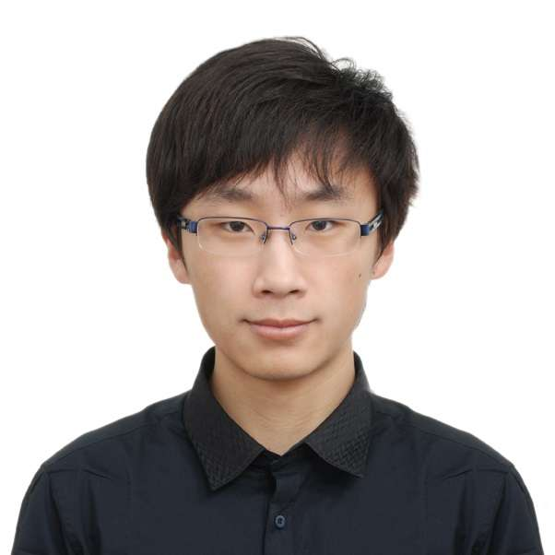
Thank You (and all users)!
T.-W. Huang
C.-X. Lin
G. Guo
M. Wong
GitHub: https://github.com/cpp-taskflow
Please star our project is your like it!
Notes:
I would like to stop here and I am happy to take any questions.

Slide 26
Back-up Slides
Be gentle to existing tools
Modern C++ enables new technology

Slide 27
Be Gentle to Existing Tools
Nobody can claim their parallel programming lib general
If yes, I understand it’s for business purpose ☺
High-performance computing (HPC) language
Enabled the vast majority of HPC results for 20 years
Too many distinct notations for parallel programming
Big-data community
Good for data-driven and MapReduce workload
Often not good for CPU/memory-intensive applications
Cpp-Taskflow
A higher-level alternative to parallel task programming
Transparent concurrency through a new C++ programming model
Currently best suitable for those with irregular compute patterns
Notes:
I want to be gentle to existing tools. Parallel computing is a huge community and there has been excellent efforts made by talented people to make parallel programming approachable and easier to handle.

Slide 28
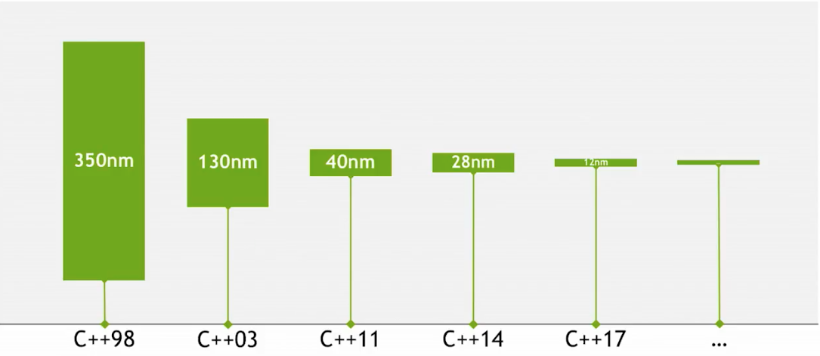
Modern C++ Enables New Technology
If you were able to tape out C++ …
Achieved the performance previously not possible
It’s much more than just being modern
Must “rethink” the way we used to write a program
IEEE Fp32/64, De-facto standards become no-brainer
Most programmers stuck with old-fashioned C++03
move semantics, lambda, threads, templates, new STL
I make small systems work
Experimenting
I am making really big systems
Notes:
Now I would like to highlight the benefit of modern C++. By modern C++ I mean C++17.To understand why this is important, I am going to make an interesting comparison. Because I am a person who work on both hardware and software designs, I am going to compare the manufacturing process at the time various C++ standards were used. Imagine if you were able to tape-out C++
In the early day, priority is to make sure that we can make little system legal, systems that you can go overboard to ignore complexity because we are coming from 350 nm to 130 nm. Things changed dramatically. It’s too difficult to have all these pieces come together to behave the same way.
Now we have 7nm technology with C++17 or 20 (new libraries, standards, idioms) that can help us largely achieved the performance and productivity previously not possible especially from the programming standpoint, even though most programmers are still with old-fashioned C++03 for various reasons legacy code, existing tools, difficult transitioning, I understand. But what I would like to highlight is the problem we have today is to make C++ legalize really big systems, IoT, cyber physical systems, and scalable AI frameworks, and those where performance is critical. This is why we are pushing to 7nm and beyond. We need to keep hardware and software go together to keep up with performance scaling.
In fact, it is much more than just being modern. Modern C++ allows us to rethink the way we used to design a program and achieve the performance and salability that were previously not possible. Like with new technology node, we can design new chips.

